Slide 1
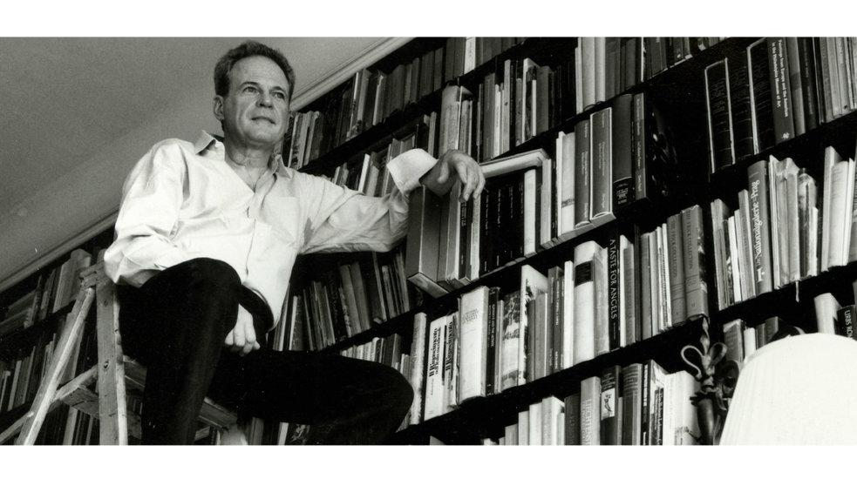

December 9, 2020
ARTchives
Everett Fahy in his house
photo Henry Bourne

Slide 2

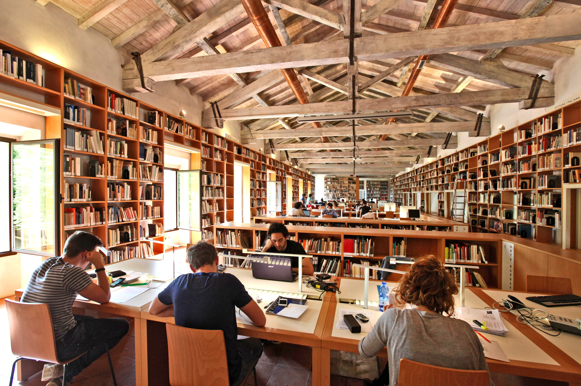
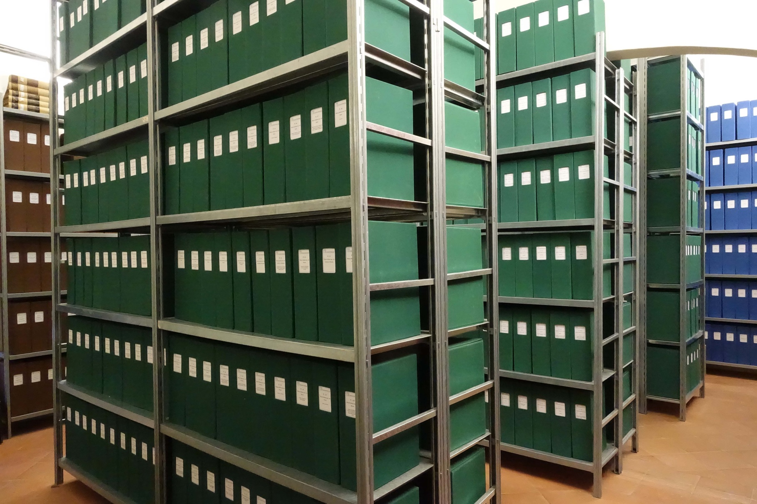
Federico Zeri Foundation (www.fondazionezeri.unibo.it)
December 9, 2020
Reading room
Federico Zeri’s Photo Archive

Slide 3
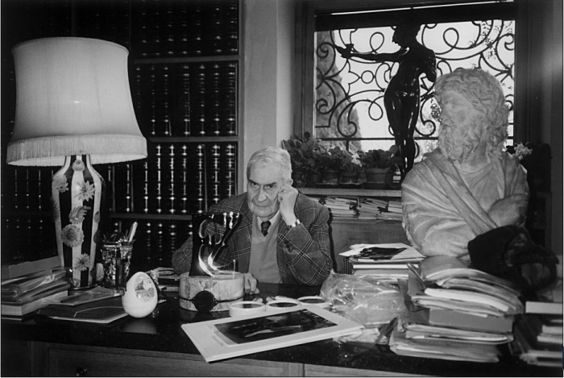
December 9, 2020
Federico Zeri (1921-1998)

Slide 4
Background
Background
December 9, 2020
Art historians' personal archives include a variety of sources (papers, expertises, correspondances, photographs etc.) documenting creators' work, their opinions, their favourite primary sources, and their scientific methodologies.
All this information, if available, shared and consistently integrated, could help to trace the trajectories of our discipline through the lenses of historiographical research.
Currently, such a vaste heritage is mainly preserved by cultural institutions, that are not always able to reveal the potential of their collections and engage a wide public. Moreover, an overview of the extent and the scope of such collections is not available yet.
Art History as a rather young academic discipline
> first university teaching of Art History created in Italy only in 1896
Art historians' personal archives are often mixed collections that may include paper documents, photographs, books and other publishing products
> archival fonds catalogued in different systems and according to different standards (ISBD, ISAD, ICCD…)
These collections are often difficult to trace and have never been internationally surveyed
Collections as resources to study specific art-historical topics dealt with by their creators, the scholars’ work and methodology, but also (as a whole) the evolution of art history
> history of art history, history of connoiseurship, history of art criticism etc.

Slide 5
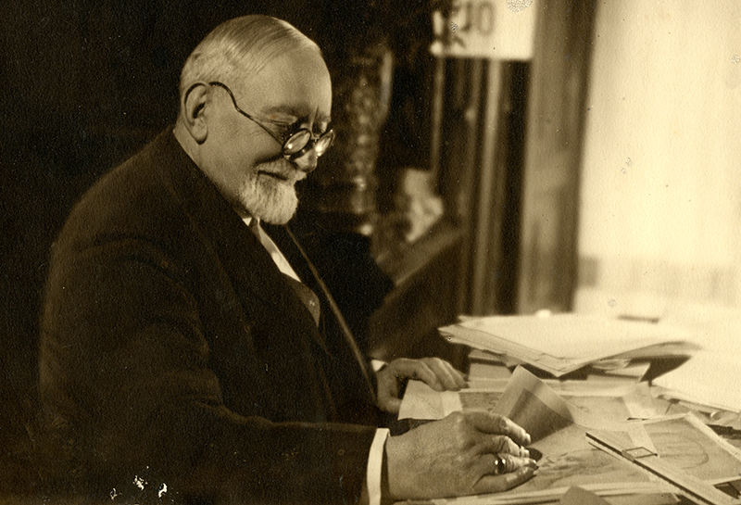
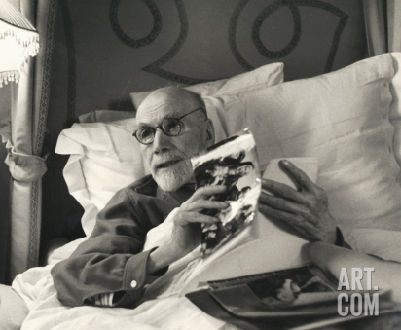
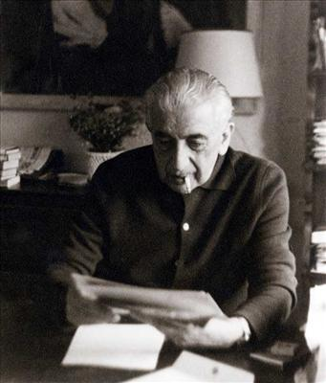
Background
December 9, 2020
Art historians' personal archives include a variety of sources (papers, expertises, correspondances, photographs etc.) documenting creators' work, their opinions, their favourite primary sources, and their scientific methodologies.
All this information, if available, shared and consistently integrated, could help to trace the trajectories of our discipline through the lenses of historiographical research.
Currently, such a vaste heritage is mainly preserved by cultural institutions, that are not always able to reveal the potential of their collections and engage a wide public. Moreover, an overview of the extent and the scope of such collections is not available yet.
Adolfo Venturi (1856-1941)
Bernard Berenson (1865-1959)
Roberto Longhi (1890-1970)

Slide 6
Scope of ARTchives
December 9, 2020
Survey of existing art historians’ archival collections
> around 90 collections have been immeditely identified, currently held by private or public institutions
Focus on personal fonds (initially)
Cataloguing of art historians’ archives
Formalize research paths among the archives’ contents

Slide 7
Objectives of ARTchives
December 9, 2020
Create a knowledge graph of art historians’ archives for historiographical research purposes
Help users to identify and retrieve archival fonds relevant to their studies
Develop an expressive web application that leverages such data
Support an agile cataloguing process by means of Semantic Web technologies
Allow researchers to answer research questions related to historiographical topics, such as: historians’ relations, debate on research topics, bibliographic sources addressing such topics

Slide 8
Research questions
December 9, 2020
KEEPER, CREATOR, COLLECTION, BIBLIOGRAPHY sections as starting points to browse and ‘read’ collections and archival materials
The subjects of the collections (art historical topics) are often involved and particularly relevant
May include and imply multiple levels of complexity

Slide 9
Research questions
December 9, 2020
KEEPERS
First level questions
Which institutions have been particularly active in collecting archives of art historians?
Do they correspond to the last creators’ working places?
Second level questions
Why were these institutions chosen as repositories for personal archives?
Is it possible to reconstruct/represent a geography of the sources for art historical and historiographical research?

Slide 10
Research questions
December 9, 2020
COLLECTIONS
First level question
Assuming the user studies a specific artist/scholar/topic, which archival funds may be of greater interest for his/her research? e.g. which funds should an art historian studying Titian / Bernard Berenson/ art exhibitions consult or consider for more in-depth investigations?
Second level question
Which are the historical periods or art-historical periodizations (Mannerism, Baroque, Neoclassical, etc.) that find the greatest references in the archives of art historians? Why?

Slide 11
Research questions
December 9, 2020
COLLECTIONS
First level questions
In what years were these archives established?
What stage in the evolution of art historical research (personal or general) do these collections reflect?
Second level question
In which years/decades did art historical research focus more on specific periods/ styles (i.e. Baroque, Mannerism, Neoclassicism etc.) or re-discovered forgotten artists/artistic schools?

Slide 12
Research questions
December 9, 2020
COLLECTIONS
First level questions
Which artistic genres or object typologies do the archival funds surveyed in ARTchives make it possible to explore?
Which funds should an art historian studying miniature/ jewellery/ sculpture/ portraits consult or consider for more in-depth investigations?
Second level question
Which are the most recurring themes in art historians’ personal archives?

Slide 13
Research questions
December 9, 2020
CREATORS
First level questions
Which are the countries of origin of the art historians who have constituted the collections?
Where did they studied?
In which institutions did they operate or teach during their career?
Second level questions
Which have been the most important centers of research in the discipline at different points in time?
What are the directives on which art historical debate developed during the last 150 years?

Slide 14
Research questions
December 9, 2020
CREATORS
First level questions
Which were the relationships that these art historians had with each others during their career?
Do the documents and materials within each collection reflect these personal and professional relationships?
Second level question
Did these relationships influence the approach of the different art historians to the discipline, and/or the choice of particular fields/topics in their studies?

Slide 15
Research questions
December 9, 2020
BIBLIOGRAPHY
First level questions
How can a user deepen the knowledge of a specific scholar and his/her personal archive?
Second level question
What are the main sources that allow to identify and study the sources of art history?
Could Bibliography quoted in ARTchives project contribute to trace the historiography of Art History?

Slide 16
Research questions
December 9, 2020
PROBLEMS
In data:
Big questions / synthetic descriptions (collection level)
Complex questions / poor data reported by catalogers
In the tool/ process:
Data extraction neither precise nor implementable (until now)
Potential of semantic data not sufficiently exploited
In the user’s approach:
Lack of comfortability of different generations of art historians in using new research tools
Agreement on art historical periods

Slide 17
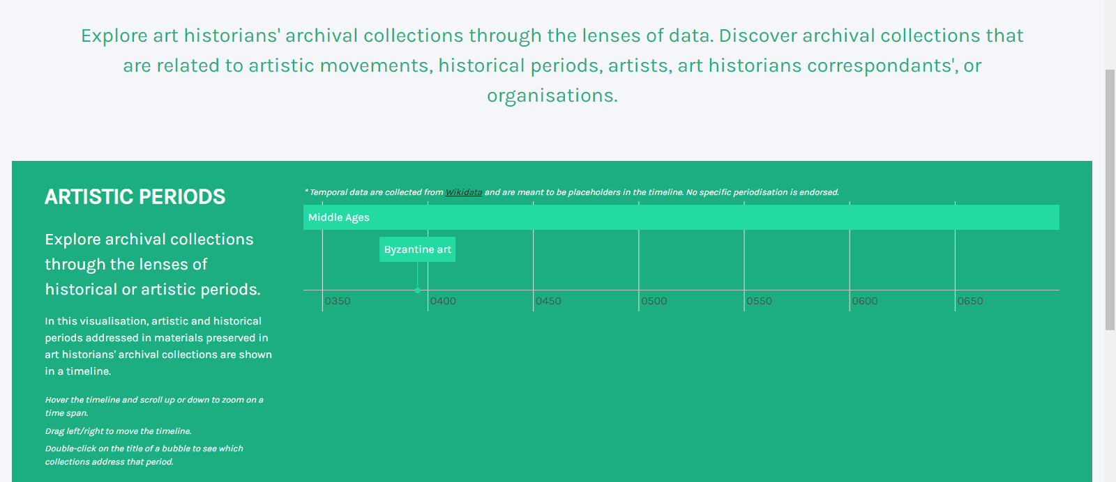
December 9, 2020

Slide 18
December 9, 2020
Questions?
francesca.mambelli6@unibo.it

